Slide 1
Labels
What are labels used for?
Containment
Protection
Convenience
Information
Selling

Slide 2
Label Types
Four Main Types
Ungummed, glue applied or wet glue labels
Pressure sensitive (or self adhesive) labels
In-mould labels
Sleeving ( Shrink and Stretch)

Slide 3
Usage of Label Type taken from Pira report The Future of Labels and Labelling for the European Market published in 2001 plus updated figures from FINAT 2003

Slide 4
Ungummed or Wet Glue Labels
Paper or plastic films
Usually require the application of adhesive to attach them to a packaging component
Referred to as "wet glue" or "wet applied" labels.
Applications include face/ neck/ back labels applied to bottles for beers & spirits, or wraparound labels, used extensively on canned goods and bottled soft drinks.

Slide 5
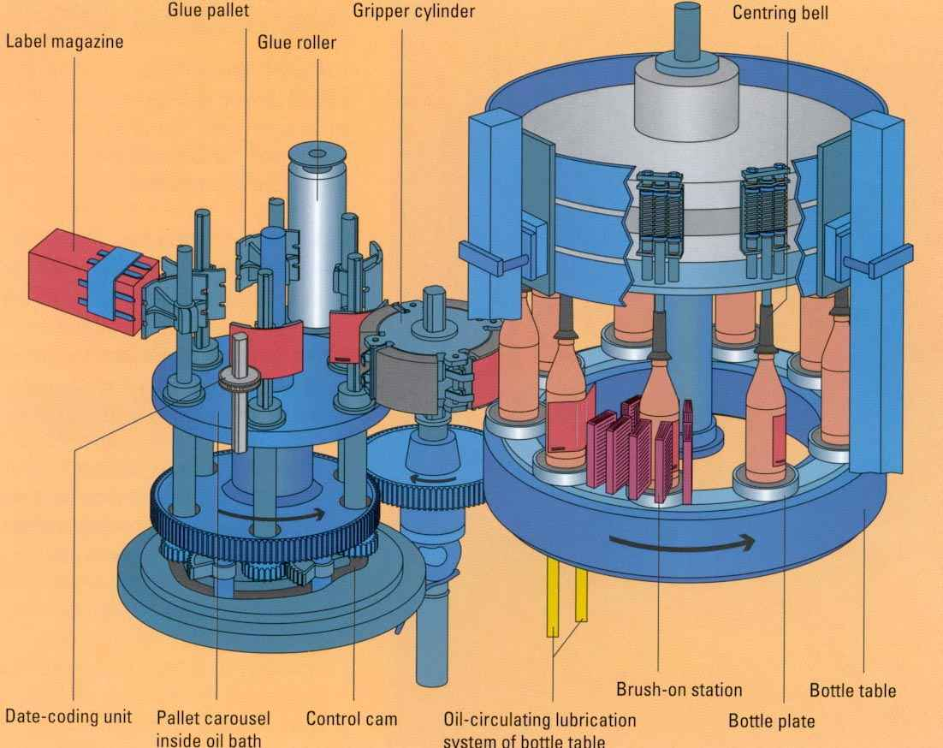
Application ‘Wet glue’ labels From Krones
Pre-cut from printed sheets
Video – KosmeSpecificallyPlacedLabels

Slide 6
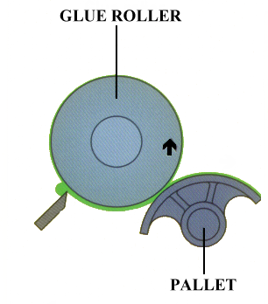
Adhesive Pickup
Stainless steel
or rubber coated

Slide 7
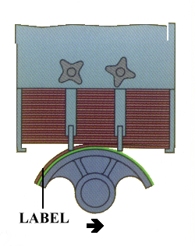
Label Pickup
Adhesive
Pallet rotation
Machine rotation

Slide 8
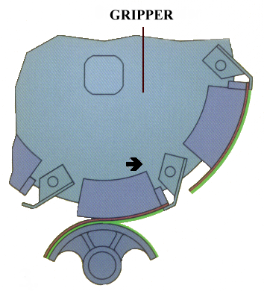
Label Transfer
Gripper Cylinder
Label
Pallet

Slide 9
Performance During Application
Paper Selection
Porosity important if vacuum pick up used
Stiffness will relate to curvature of the container
Water absorbency will affect speed of wetting out and also speed of application

Slide 10
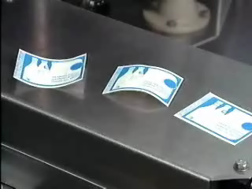
Performance During Application
Paper Curl
Printed paper is like a bimetallic strip and will curl if stored in damp conditions
Grain direction must be specified - Paper when wetted during label application will curl

Slide 11
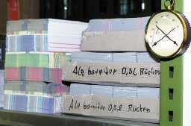
Performance During Application
Label Storage
Krones recommend labels are stored at 18 - 22 ºC, with a relative humidity of 60 - 70%

Slide 12



Performance During Application
Effects of poor storage
Printed
side
TOO DRY
TOO DAMP
Printed
side
GOOD LABEL

Slide 13
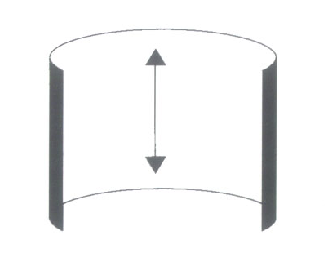
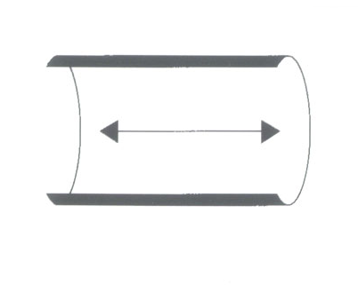
Performance During Application
Grain direction
should be specified to the label supplier
Usually parallel to base of label
Grain direction must be correct, otherwise labels may start to lift off the container at the machine discharge
INCORRECT
CORRECT

Slide 14
Ungummed ‘Wet Glue’ labels
Other Aspects
Consider selection of adhesive:
Label substrate
Container material
Usage conditions
Usually high-speed application
Usually slow changeover

Slide 15
Self Adhesive Labels
For the User
Higher cost
but cleaner to apply
Faster change over times
no maintenance of adhesive application stations
Usage now exceeds that of wet glue labels
1970 – Wet Glue 70%, Pressure Sensitive 5%
2002– Wet Glue 34%, Pressure Sensitive 50%

Slide 16
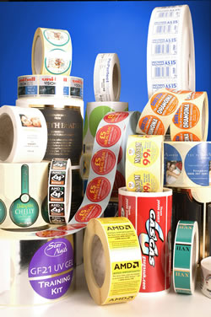
Self Adhesive Labels
Usually reel-fed
Typical construction
Face material – The label
A coating of adhesive
A release coat
A carrier web

Slide 17
Self Adhesive labels
The adhesive used depends on
Substrates
label & container
Storage
ambient or frozen
End use
permanent or easy peel

Slide 18
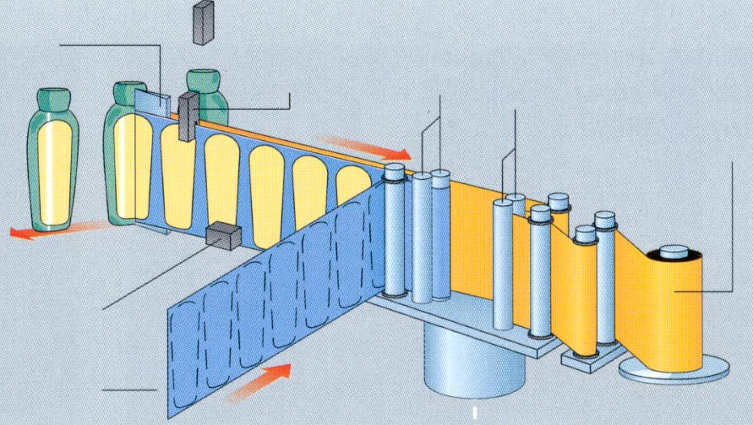
Self adhesive labelling from Krones
Application Wedge or Beak
Light Sensor - START
Light Sensor - STOP
Drive Rollers
Driven Rollers
Rewind unit for the empty label carrier web
Hot date stamping (optional)
Label Carrier web
Servomotor

Slide 19
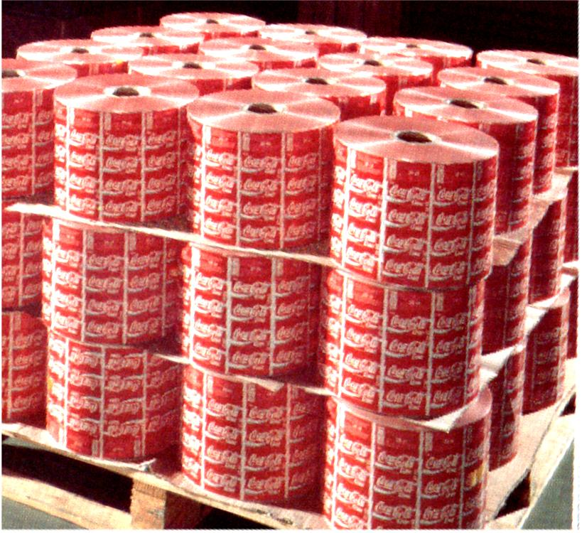
Self Adhesive Labels
Storage
Store and use within 6 months
Adhesive tends to ‘bleed’ around the die cut edge – unwinding problems, especially in warm storage
Storage
Always horizontally
never on the face
to prevent reel distortion

Slide 20
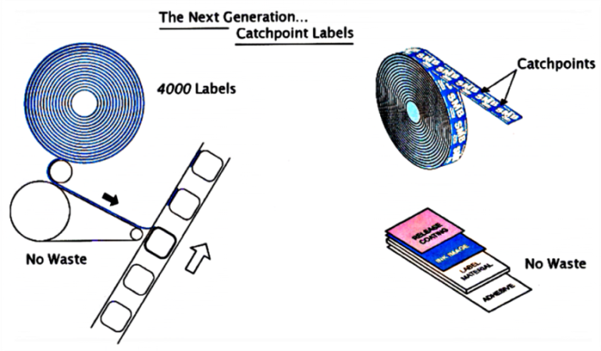
Self adhesive labels V Wet Glue labels
Summary of application methods
Adhesive specified as part of label
Slower speed than ungummed labels
Faster changeover
More flexible
Environmental Considerations

Slide 21
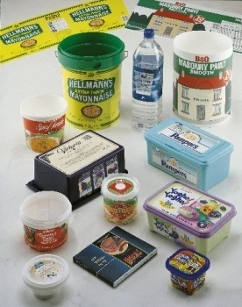
In-Mould Labels
Pre-cut in stacks or reel-fed
Plastic films – fuse directly to container
Paper pre-coated with heat sensitive adhesive
Offers High Quality printing (gravure, offset litho) over large area, excellent adhesion, resistance to scuffing

Slide 22
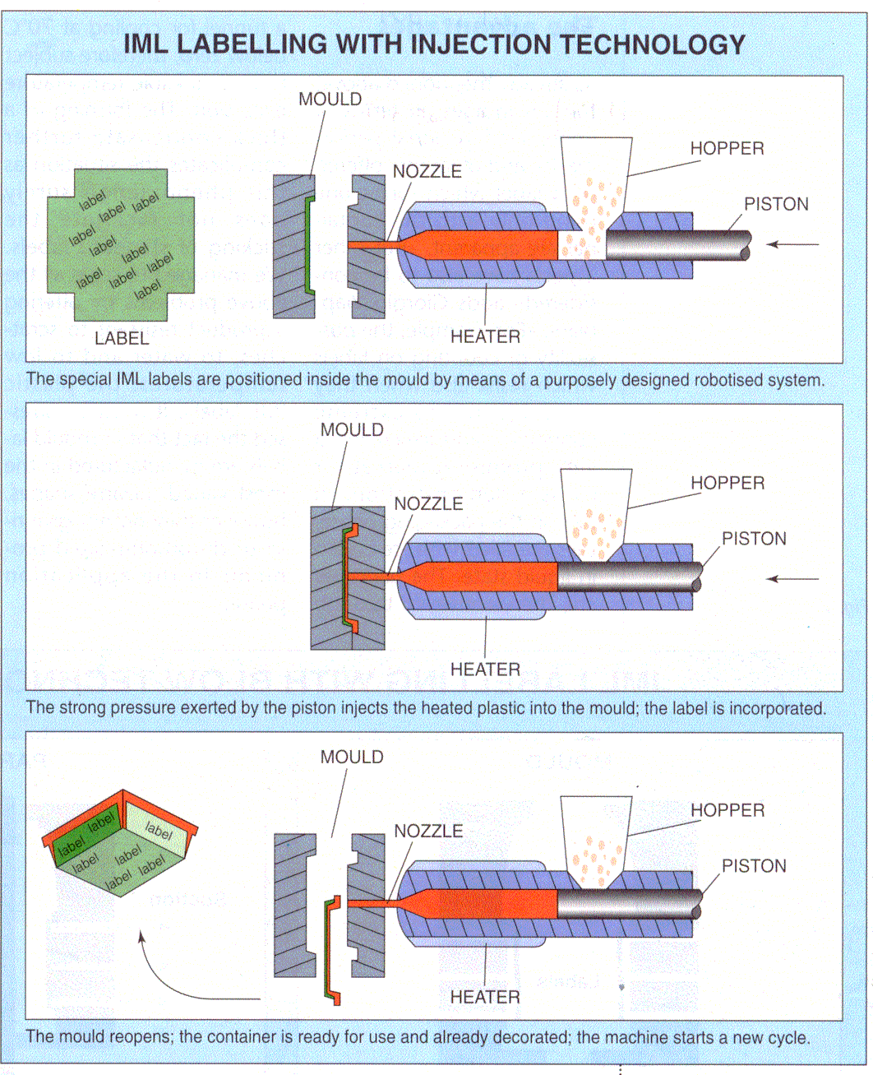
Packaging and Bottling International magazine: www.fimer.it

Slide 23
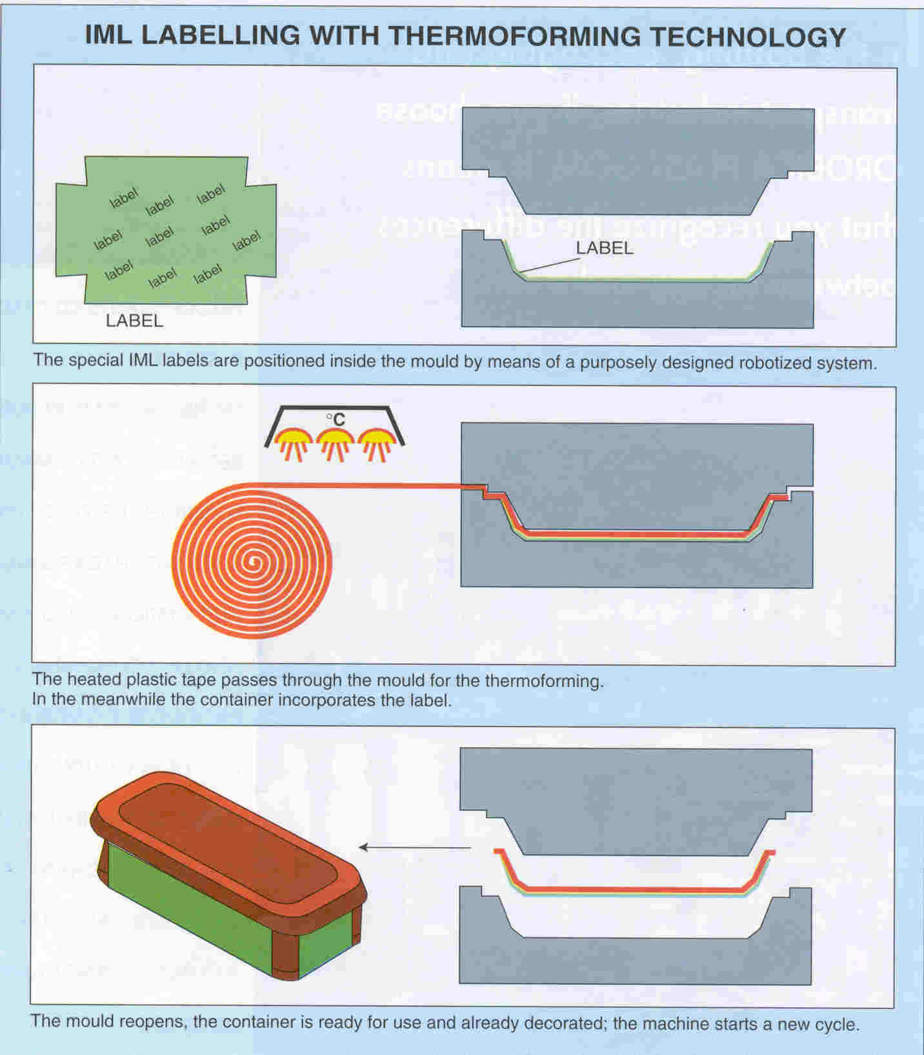
Packaging and Bottling International magazine: www.fimer.it

Slide 24
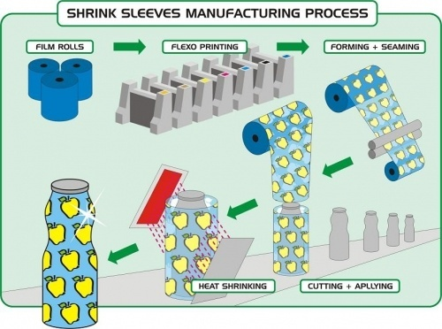
Sleeving
Printed film sleeves
Rapidly growing section of the market
Good scuff resistance – reverse printed
All round decoration
Ability to label complex shapes

Slide 25
Sleeving
Materials used
Shrink characteristics
Clarity
Printability

Slide 26
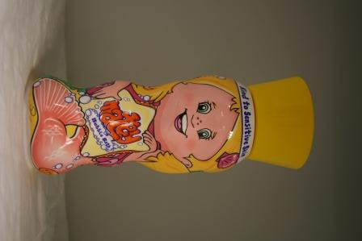
Shrink Sleeving
Application:
Consider shrink characteristics
Distortion of design after shrinking
Sleeve application as part of container production or packer/filler operation?
Supplied in reels or sometimes pre-cut

Slide 27
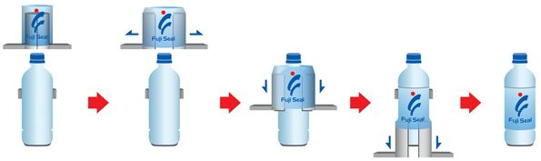
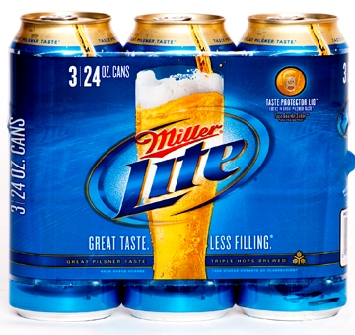
Stretch Labelling
Shrink Labelling without the heat
Label stretched over pack can be stretched up to 50%
Often used in multipacks
No adhesives used
No heat energy used to shrink the label onto the container
lower cost than shrink sleeves

Slide 28
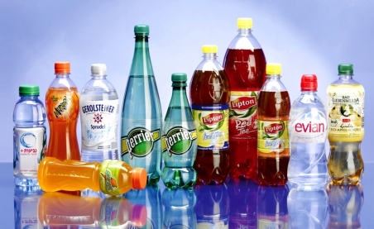
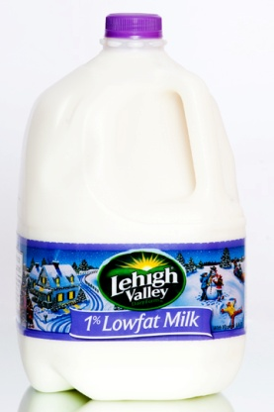
Stretch Labelling
Labels are typically PE
Easily removable in recycling operations
Machine speeds achievable - 450/min (900/min with two lane machine
Cannot be applied to complex shapes
Stretch Labelling Video

Slide 29
Test requirements
Print adhesion / rub resistance
Surface slip – important for application
Corrosion – labelling of cans
Product resistance – spillage after use
Odour effect on product and with handling
Colour fastness – fading

Slide 30
Other requirements
Colour standards & Text standards
Gloss levels
Dimensional standards
Curl specifications – for paper
Winding direction to machine specification
Delivery specifications – unique to each user

